Slide 1
Sistem Pengolahan Citra Pertemuan 5 – Image Enhancement (Part 2)
Alfa Satya Putra
Sistem Komputer
SISTECH UPH

Slide 2
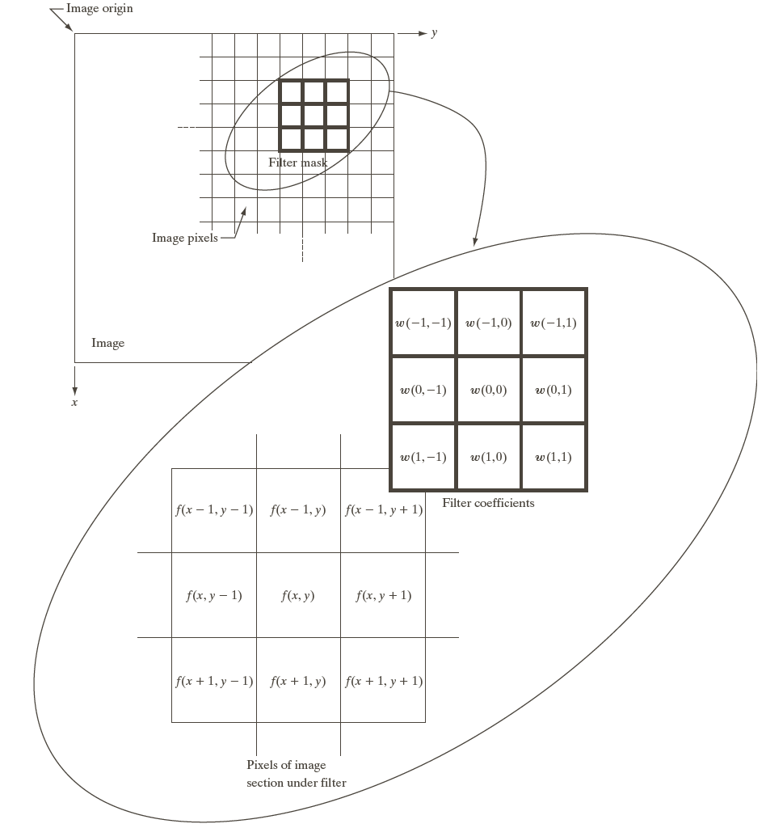
Spatial Filtering
Work with image pixel values and mask/filter (subimage) coefficients
Has roots in frequency domain filtering
Move filter mask from point to point in an image, measure response at each point
For linear spatial filtering, response given by sum of product of filter coefficients and corresponding pixels in area spanned by filter mask
Example: 3x3 mask (figure), result R at point (x,y) = w(-1,-1)f(x-1,y-1) + w(-1,0)f(x-1,y) + … + w(1,1)f(x+1,y+1)
For mask size m x n, assume m = 2a+1, n = 2b+1; a,b nonnegative integers (masks will be odd size)

Slide 3
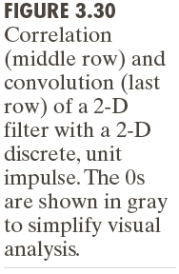
Example – Convolution and Correlation in 1D & 2D

Slide 4
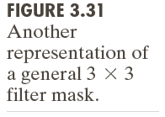
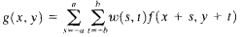
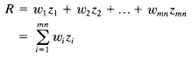
Spatial Filtering
In general, linear filtering of image f (size M x N) with filter mask of size m x n is given by (a = (m-1)/2 and b = (n-1)/2):
Equation must be applied to x=0,1,…M-1 and y=0,1,..N-1
Linear spatial filtering similar to convolution
In terms of mask response R (w=mask coefficient, z = image gray level, mn = total coefficients in mask):
How to handle image borders/edges?
Limit center of mask to (n-1)/2 pixels from border (smaller resulting image, all pixels processed by full mask)
Filter all pixels only with section of mask fully contained in the image (partial filtering at the edges)
Padding original image by adding rows and columns of 0’s or replicating columns, cut padding at result

Slide 5
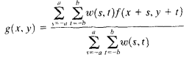
Smoothing Linear Filter
Sometimes referred as lowpass filter
Replace pixel value with average of gray levels in the neighborhood by mask, reduce sharp transitions in gray levels
Can reduce noise, blur edges
Averaging (3.32a) and weighted averaging filter (3.32b)
Mask coefficients sum to 1
General function of result:
Denominator = sum of mask coefficients (compute only once)

Slide 6
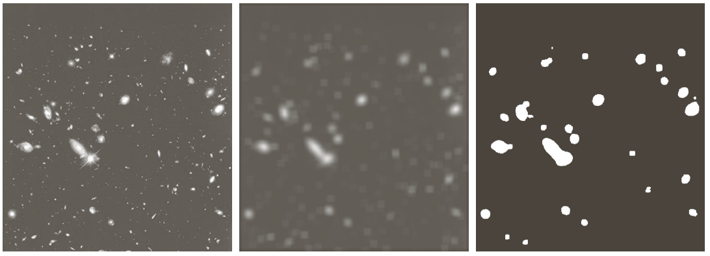
Smoothing Filter Examples

Slide 7
Order Statistics Filters
Nonlinear spatial filter, response based on ordering/ranking of pixels in mask, replace center pixel with ranking result
Example: median filter (replace pixel by median of gray levels in mask)
For 3x3 mask, median is 5th largest value
Force points with distinct gray level to be more like their neighbors (conformity)
Effective in noise reduction, especially impulse/salt-and-pepper noise (appear as white and black dots on image)
Other examples: max filter, min filter

Slide 8
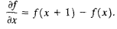
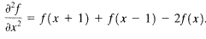
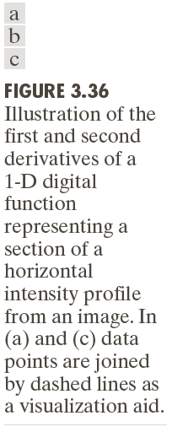
Sharpening Spatial Filter
Highlight fine detail/enhance blurred detail
Averaging analogous to integration → sharpening can be done by differentiation
Enhances edges and noise, de-emphasize areas with slow varying gray levels
Based on first and second order derivative:
First order derivative produce thicker edge, stronger response to gray-level step; second order have stronger response to fine detail, double response at step change in gray level, generally better suited for image enhancement
Also called the highpass filter

Slide 9
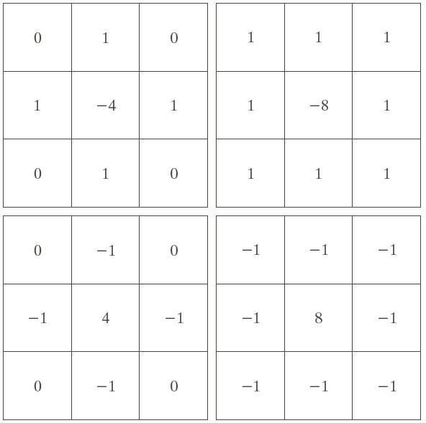
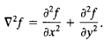
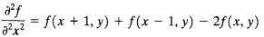
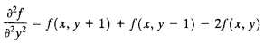
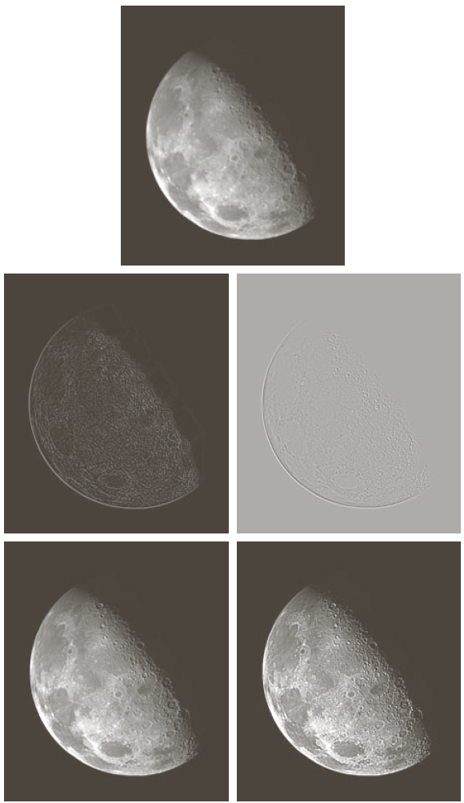
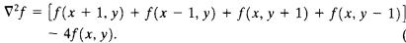
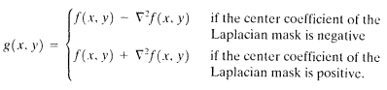
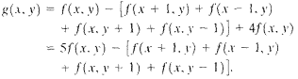
Second Derivative – The Laplacian
Laplacian for image f(x,y) defined as:
Resulting in a mask in 3.37a
Laplacian use for image enhancement:
Simplified version:

Slide 10
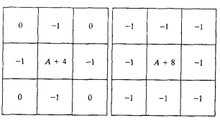
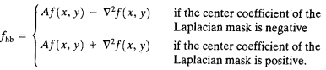
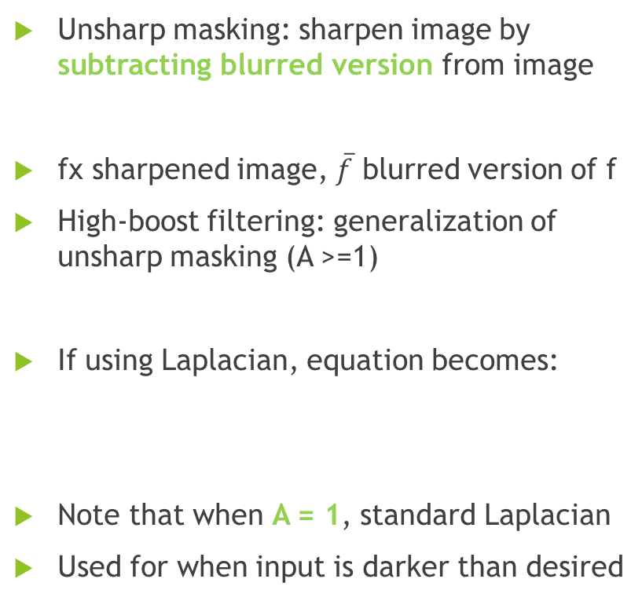
Unsharp Masking and High-boost Filtering
Unsharp masking: sharpen image by subtracting blurred version from image
fx sharpened image, $\overline{f}$ blurred version of f
High-boost filtering: generalization of unsharp masking (A >=1)
If using Laplacian, equation becomes:
Note that when A = 1, standard Laplacian
Used for when input is darker than desired

Slide 11
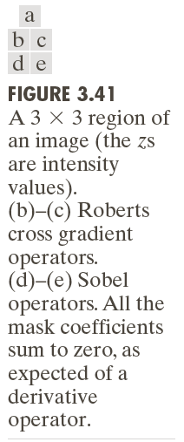
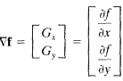
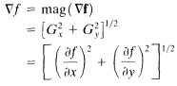
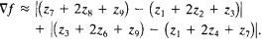
First Derivative – The Gradient
Gradient f at (x,y) defined by:
Magnitude given by:
Assume 3x3 filter, equation becomes:
Mask in 3.41d&e called Sobel Operators, coefficients sum to 0, response=0 in constant gray level
Used in detection of defects, preprocessing for automated inspection

Slide 12
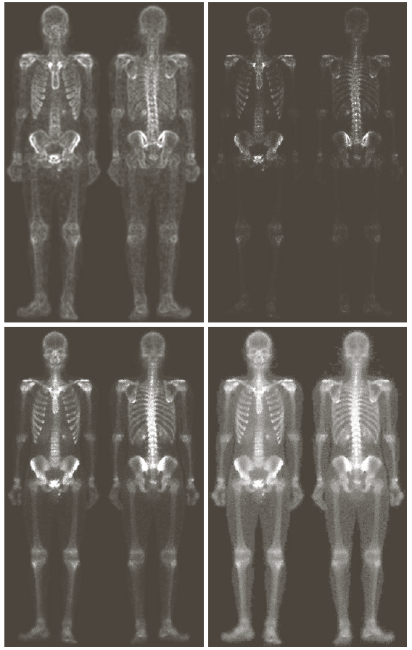
Combining Spatial Enhancement Methods

Slide 13
Fuzzy Spatial Filtering

